Slide 1
Advanced Client-Side Development
Setting up an API, Fetching Data with Axios, Display API data, CRUD operations

Slide 2
Prerequisites
Visual Studio 2017 (Version 15.7 or later)
.NET Core SDK 2.1
MS SQL Server Management Studio
SQL Server
Workloads
ASP.NET and web development (under Web & Cloud)
.NET Core cross-platform development (under Other Toolsets)

Slide 3
Sequence (Backend)
Creating a new Database
Create New Project
Adding the Database Connection string
Create Model based on Database
Will add DBContext model class
Registering the context with dependency injection
Adding the Controllers

Slide 4
Creating Database Tables (Student Only)
Student
ID
FirstName
LastName
EnrollmentDate
Course
CourseID
Title
Credits
Notes:
Many to many relationship

Slide 5
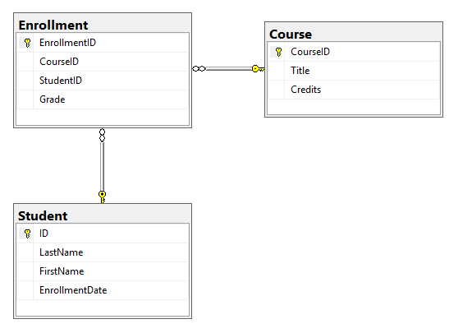
Breaking the many to many relationship
Enrollment
EnrollmentID
CourseID
StudentID
Grade

Slide 6
Creating a new Project
Open Visual Studio and File -> New -> Project
Select MVC model inside a Core Website template.

Slide 7
Check connection with Server and Database
Tools –> Add SQL Server
Data Source
Microsoft SQL Server (SqlClient)
Server Name
DELL-INSPIRON (Whatever your server name is)
Database Name
School (In which our three tables are present)

Slide 8
Adding the Database connection string
In appsettings.json project file we add connection string to our Database Server (Please note that you would write your own credentials):
"ConnectionStrings": {
"Connection": "Server=DELL-INSPIRON;Database=School;Trusted_Connection=True;"
}
//DELL-INSPIRON is my server name could be different depending on what your //server name is + Database will be created for you with this name

Slide 9
Create Model based on Database
Tools –> NuGet Package Manager –> Package Manager Console
Run the following command to create a model from the existing database:
Scaffold-DbContext -Connection name=Connection -Provider Microsoft.EntityFrameworkCore.SqlServer -OutputDir Models
Notes:
Microsoft.EntityFrameworkCore.Tools
Microsoft.EntityFrameworkCore.SqlServer
Microsoft.AspNetCore.Cors

Slide 10
Registering the context with Dependency Injection
In startup.cs project file we add this code in ConfigureServices method
services.AddDbContext<SchoolContext>(options => options.UseSqlServer(Configuration.GetConnectionString("Connection")));

Slide 11
Adding the Controllers
Right click on the Controller folder in your project and add Controller:
Select API Controller, using Entity Framework

Slide 12
Configure CORS in your Startup.cs file:
In the ConfigureServices method of your Startup.cs file, add the following code to enable CORS:
services.AddCors(options =>
{
options.AddPolicy("AllowReactApp",
builder =>
{
builder.WithOrigins("http://localhost:3000")
.AllowAnyHeader()
.AllowAnyMethod();
});
});

Slide 13
Configure CORS in your Startup.cs file:
In the Configure method, make sure to use UseCors before UseEndpoints:
app.UseCors("AllowReactApp");

Slide 14
Create react app
Create-react-app interface
Npm install axios
Get the components, apiConfig and app from blackboard
Understanding the react code

